Slide 1
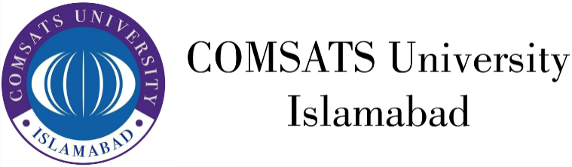
HUM111 Pakistan Studies
Lecture 12

Slide 2
HUM 111 Pakistan Studies
Lecture 12
Natural Resources and Culture of Pakistan
Land and People of Pakistan
Dr. Sohail Ahmad

Slide 3

More About Pakistan [1/4]
Country name: Islamic Republic of Pakistan
Government type: Federal Republic
Administrative division:
Four provinces
One capital territory
Federally Administrated Tribal Areas,
Gilgit Baltistan
The Pakistani-administered portion of the disputed Jammu and Kashmir region includes Azad Kashmir.

Slide 4
More About Pakistan [2/4]
Pillars of the Government System
Legislation
Administration
Judiciary
Defense
Media
Political Pressure groups
Military
Ulema
Landowners, industrialists and small merchants also influential

Slide 5
More About Pakistan [3/4]
Export commodities: garments, bed linen, cotton cloth and yarn, rice, leather goods, sports goods, chemicals, carpets and rugs
Imports commodities: petroleum, petroleum products, machinery, plastics, transportation equipment, edible oils, paper and paperboard, iron and steel, tea.

Slide 6
More About Pakistan [4/4]
Currency code: PKR
Internet country code: .pk
Radio broadcast stations: AM, 31 and FM, 68 (approx.)
TV stations: 90 (approx.)
International Air ports: 08
Airports: 50 (approx.)
Sea ports: 05 (Baluchistan), 03 (Sindh)
Dry ports: 11
Railway Stations: 34

Slide 7
Fishery in Pakistan
Fishery and fishing industry plays an important role in the national economy of Pakistan.
With a coastline of about 1046 km, Pakistan has enough fishery resources that remain to be fully developed.
It is also a major source of export earning.

Slide 8
Forests in Pakistan
About only 4% of land in Pakistan is covered with forests.
The forests of Pakistan are a main source of food, wood for domestic use, paper, fuel wood, rubber, medicine as well as used for purposes of wildlife conservation and tourism.

Slide 9
Mining in Pakistan
The Salt Range in the Potohar Plateau has large deposits of rock salt.
Pakistan has extensive mineral resources, including fairly sizable reserves of gypsum, limestone, chromites, iron ore, rock salt, silver, gold, precious stones, gems, marbles, tiles, copper, sulfur, fire clay, silica sand.

Slide 10
International Agreements
Pakistan is a party to several international agreements related to environment and climate, the most prominent among them are:
Specific Regions and Seas , Law of the Sea, Ship Pollution (MARPOL 73/78)
Atmosphere and Climate, Climate Change, Ozone Layer Protection
Biodiversity, Environment, and Forest: Desertification, Endangered Species, Environmental Modification, Marine Life Conservation
Wastes: Dangerous Wastes
Rivers Indus Waters Treaty

Slide 11
Culture
Way of life based on traditions, value systems, norms and common goal.
Culture consists of patterns, explicit and implicit, of and for behavior acquired and transmitted by symbols, constituting the distinctive achievement of human groups, including their embodiments in artifacts; the essential core of culture consists of traditional ideas and especially their attached values; culture systems may, on the one hand, be considered as products of action, on the other hand, as conditioning influences upon further action.

Slide 12
Culture in Pakistan [1/3]
The society and culture of Pakistan comprises numerous ethnic groups: the Punjabis, Kashmiris, Sindhis in east, Muhajirs, Makrani in the south; Baloch and Pashtun in the west; and the ancient Dardic, Wakhi, Baltistani and Burusho communities in the north. The culture of these Pakistani ethnic groups have been greatly influenced by many of its neighbors, such as the other South Asians, Turkic peoples as well as the peoples of Central Asia and the Middle East.
Pakistani culture is:
Multi-cultural
Socially diversified

Slide 13
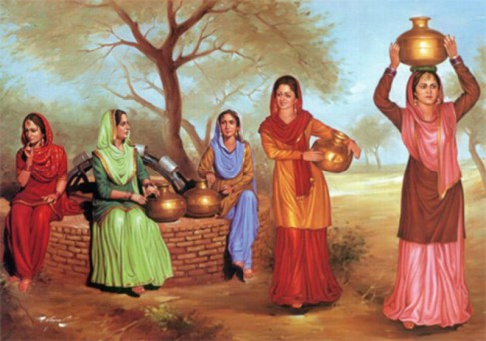
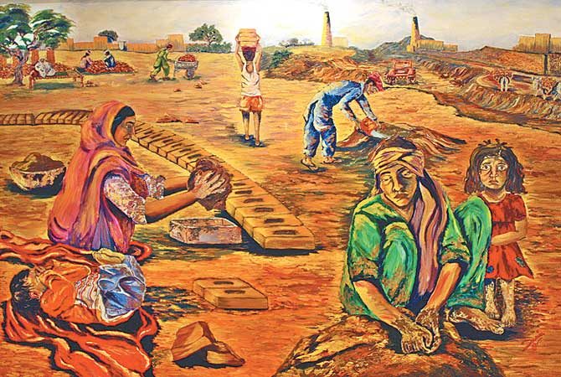
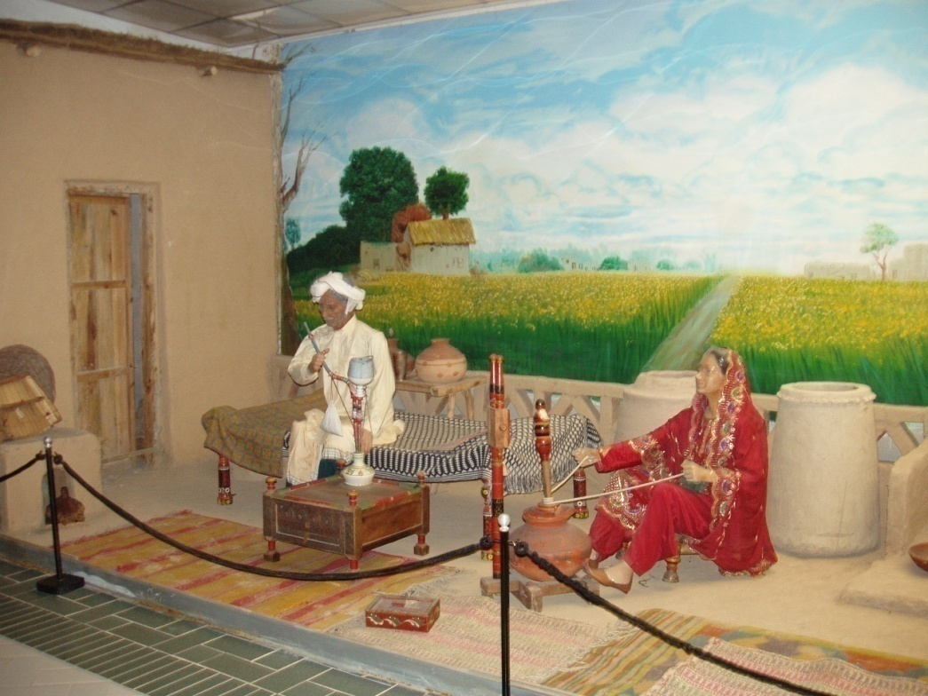
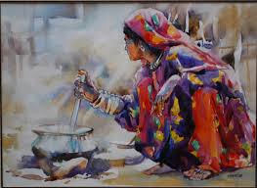

Slide 14
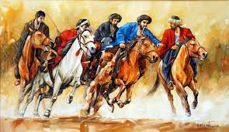
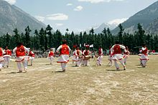
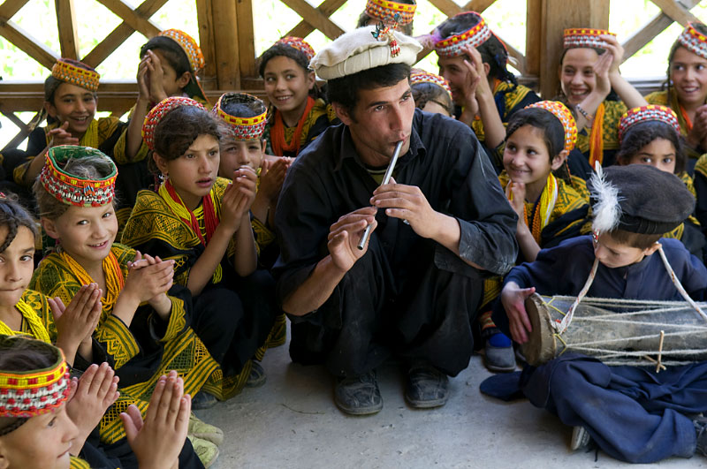

Slide 15
Culture in Pakistan [2/3]
Pakistani literature originates from the time when Pakistan gained its independence as a sovereign state in 1947.
The common and shared tradition of Urdu literature and English literature of Greater India was inherited by the new state.
Over a period of time, a body of literature unique to Pakistan emerged, written in nearly all major Pakistani languages, including Urdu, English, Punjabi, Pashto, Seraiki, Balochi, and Sindhi.

Slide 16
Culture in Pakistan [3/3]
Music, folk, qwali, ghazal, western
Dance, attan, khattak, Kahtak, ludi, hojamalo, bhangra

Slide 17
Multi-Cultural
Regions
Languages
Subcultures
Castes
Tribes
Rural
Urban (Metropolitan, city and towns)
Elite
Religions
Sects

Slide 18
Socially Diversified
Rich
Poor
Managers
Workers
Officers
Subordinates
Teachers
Students
Doctors and Engineers, etc.

Slide 19
Conclusion
We have now come to understand that Pakistan is a pluralistic cultural society, combined with multi-culturalism and social diversities which have been playing a constructive role in political development of the country.

Slide 20
Source
Some of the text for these slides has been taken from a student paper submitted to Griffith University

